Slide 1
MILANO, LIDO render

Slide 2
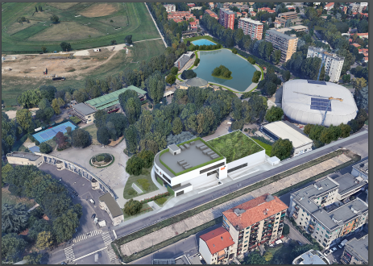
AERIAL VIEW

Slide 3
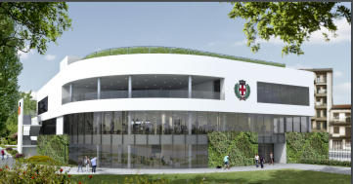
FRONT VIEW

Slide 4
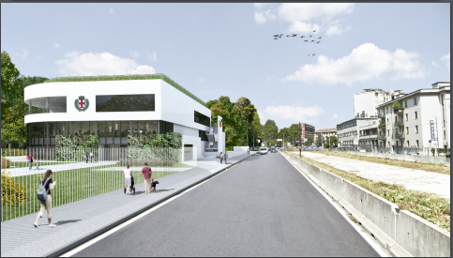
STREET VIEW

Slide 5
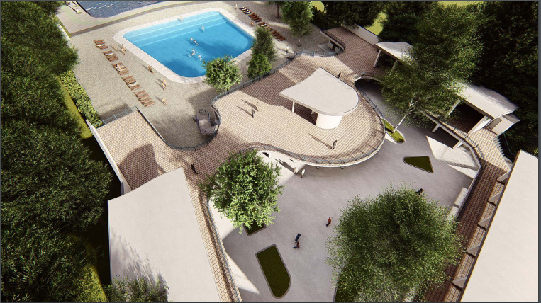
SUMMER POOL

Slide 6
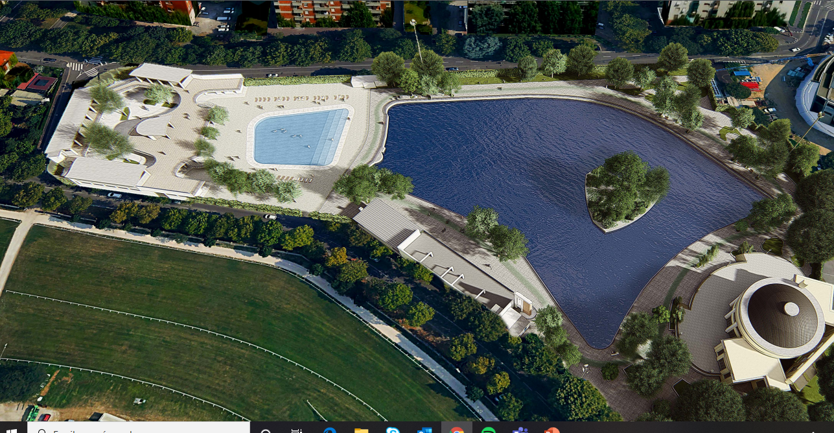
SUMMER POOL, LAKE AREA

Slide 7
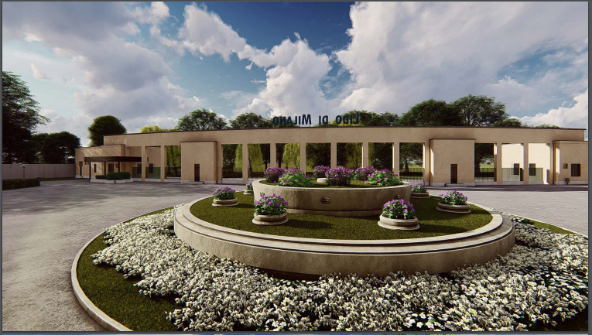
ENTRANCE TO LIDO

Slide 8
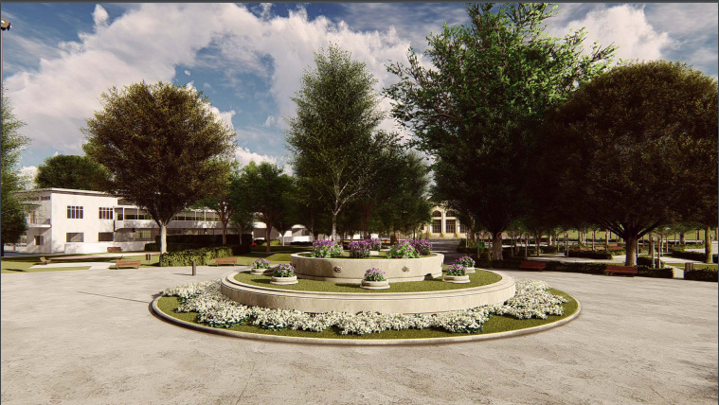
FOUNTAIN

Slide 9
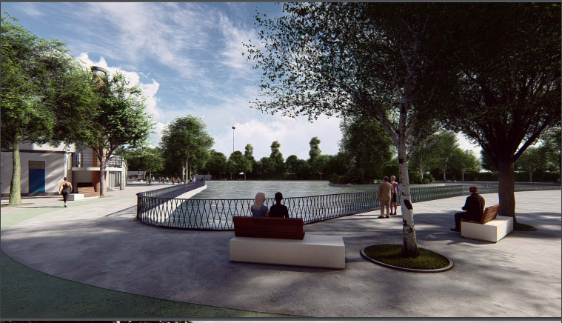
LAKE AREA

Slide 10
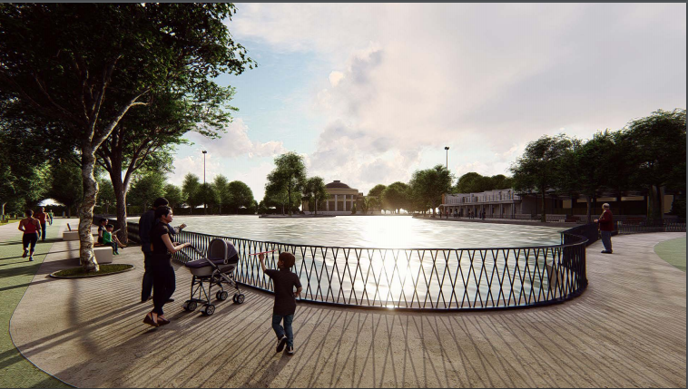
LAKE AREA

Slide 11
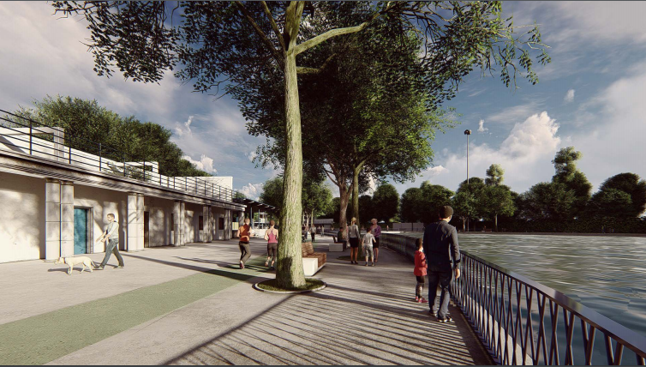
LAKE AREA

Slide 12
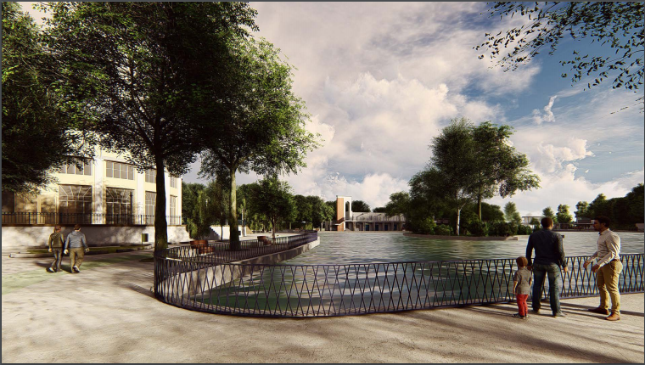
LAKE AREA

Slide 13
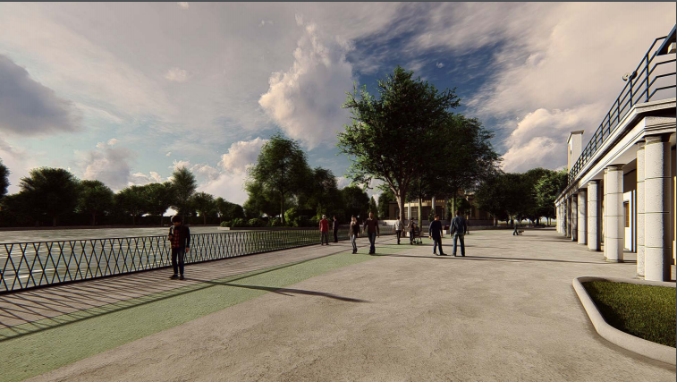
LAKE AREA

Slide 14
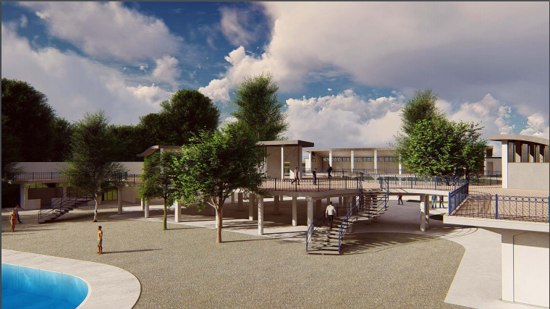
SECOND PHASE

Slide 15
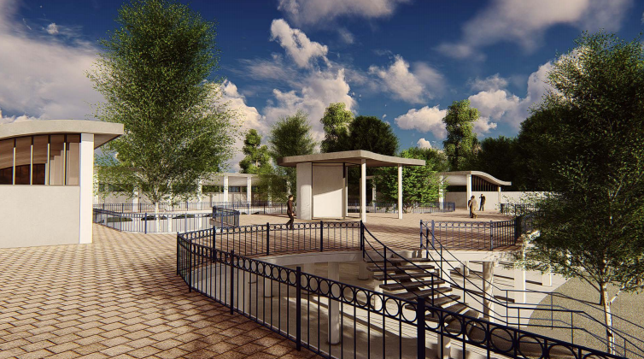
SECOND PHASE

